Slide 1
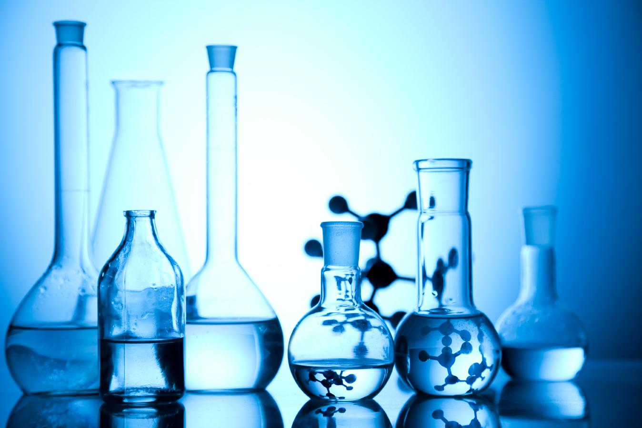

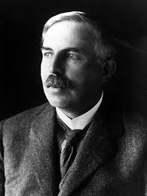
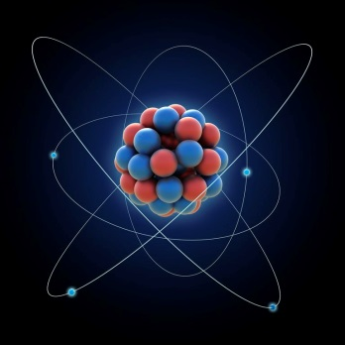
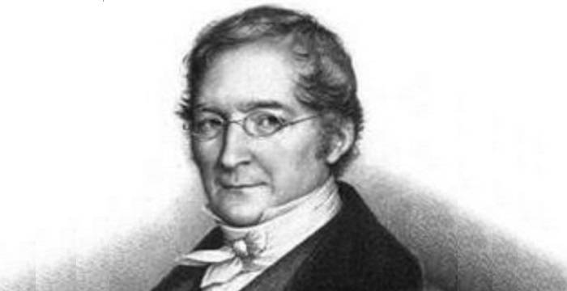
ATOMS AND MOLECULES

Slide 2

MODULE : 1
Introduction to matter

Slide 3

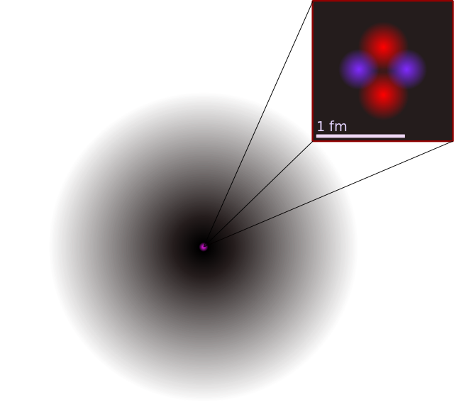
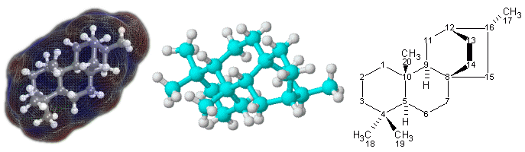
Atoms and molecules

Slide 4
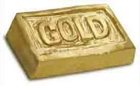
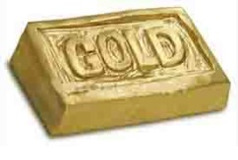







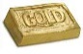
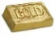

If some how we could go on dividing matter
we will get smaller and particles. Ultimately
we will get the smallest particle of matter
which cannot be divided any further. This
smallest particle of matter will be atom
All matter is made up of
small particles called atoms
and molecules.

Slide 5


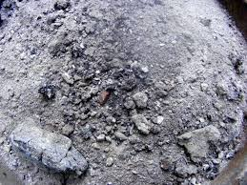
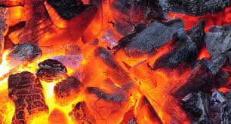
Let us study Burning Reactions
On burning charcoal, it leaves ash at the end.
Where does
the matter
charcoal go??

Slide 6

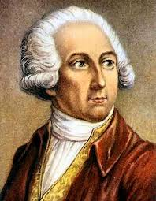
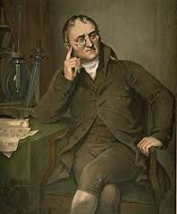
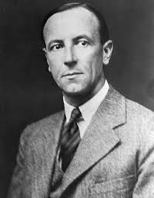
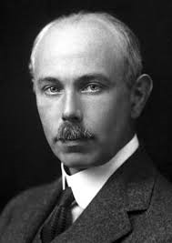
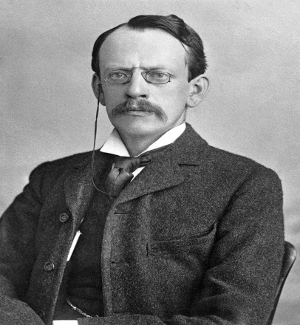
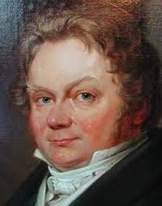
These questions and several other similar questions fascinated
scientists for many years.
Burning and combustion reactions, puzzled them to a greater extent.

Slide 7
MODULE : 2
Law of chemical combination, Law of conservation of mass

Slide 8
Lavoisier studied combustion reactions in detail.

Slide 9
Was a French nobleman.
He was able to find the masses of
reactants and Products accurately
irrespective of their physical states.
He made many important contributions to
chemistry and some call him the Father
of Modern Chemistry.
Based on these observations he proposed
the law of conservation of mass.
Antoine Lavoisier
(1743 – 1794)

Slide 10
Aim:
To find out the change in the mass before and after a chemical reaction.
Materials required
Barium chloride
Thread
Sodium sulphate
Retort stand
Distilled water
Spring balance
Conical flask
Rubber cork
Small test tube

Slide 11

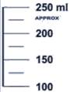
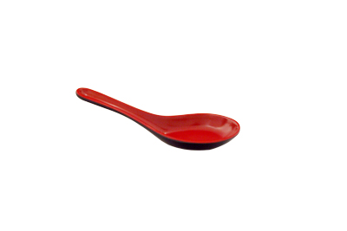

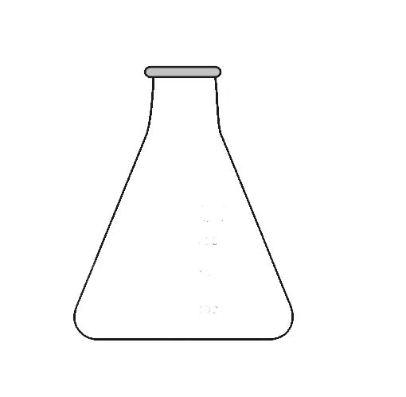
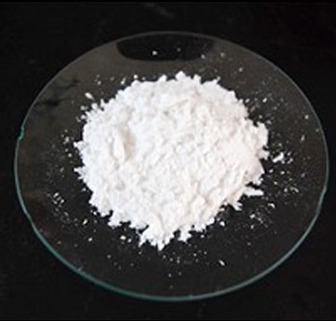
Procedure :
Prepare a solution of Barium chloride by dissolving barium chloride in distilled water in a 250 ml conical flask
Barium chloride
Distilled
water
100 ml
75 ml
50ml
25 ml
Barium chloride
Conical flask

Slide 12
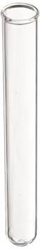
Procedure :
3. Take some solution of Barium chloride in a small test tube from
the above prepared solution.
4
3
Barium chloride
2
1

Slide 13
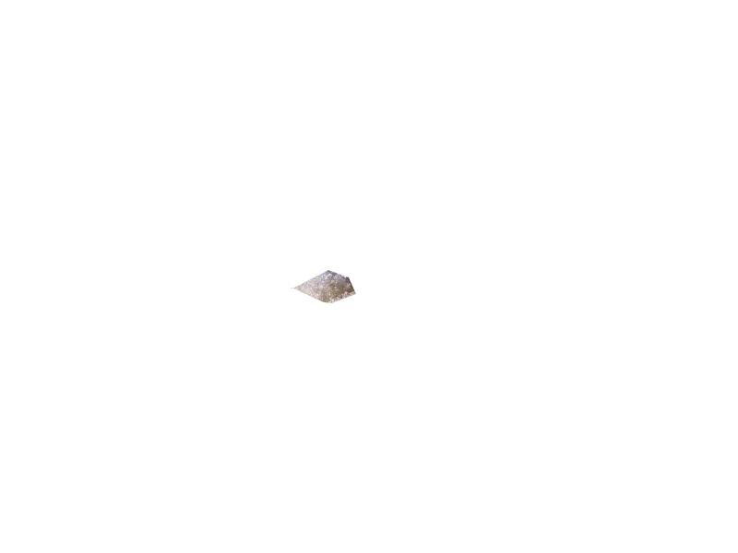
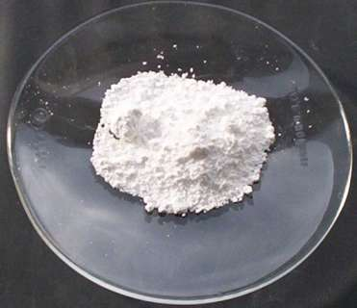
Procedure :
Prepare the Sodium sulphate solution by dissolving sodium sulphate in water in another conical flask
Sodium sulphate
distilled
water
100 ml
75 ml
50ml
Sodium sulphate
25 ml
Conical flask

Slide 14

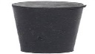
Procedure :
Hang the test tube containing
of Barium chloride solution in
the conical flask containing
Sodium sulphate solution carefully,
without mixing the solution close
the flask with a cork.
Weight the flask with its contents
carefully using spring balance
Retort stand

Slide 15
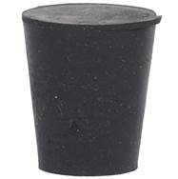
Procedure :
6. Now tilt and swirl the flask, so that
the two solutions mix.

Slide 16
Procedure
Weight the flask again using the
same spring balance as shown in.
8. Record your observations:
Weight of flask and contents
before mixing = Weight of flask
and contents after mixing
Retort stand

Slide 17
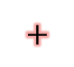
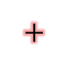
Barium chloride when reacts sodium sulphate, White precipitate of barium sulphate is formed along with sodium chloride.
$$+$$
$$+$$
BaCl₂
Na₂SO₄
BaSO₄
2
NaCl
(White ppt)
A chemical reaction takes place and the mass remains same before and after the chemical reaction. Therefore mass is neither created nor destroyed in the chemical reaction.

Slide 18

The chemical reaction taking place in the above experiment can be
written as:
Barium chloride
(Solution)
Sodium sulphate
(Solution)
Barium sulphate
(White solid)
Sodium chloride
(Solution)
In an experiment to verify the law of conservation of mass, the following
data was obtained:
i) Mass of barium chloride taken = 20.8 g
ii) Mass of sodium sulphate taken = 14.2 g
iii) Mass of barium sulphate formed = 23.3 g
iv) Mass of sodium chloride formed = 11.7 g

Slide 19
In this case, barium chloride and sodium sulphate are reactants.
Mass of reactants = 20.8 +14.2 g
= 35.0 g
Here, barium sulphate and sodium chloride are products.
Mass of products = 23.3 g + 11.7 g
= 35.0 g
Since the total mass of products (35 g) in this chemical reaction is equal to the total mass of reactants ( 35 g) therefore, the given data verifies the law of conservation of mass.

Slide 20
Law of Conservation Mass
Lavoisier, carried out the burning of charcoal in
a closed apparatus and found no change in mass.
Antonie lavoisier on the basis of his experiment
he proposed the law of conservation of mass
It states that “Matter is neither created nor
destroyed during a chemical reaction”
More simply the mass
of products is equal to
the mass of the reactants
in a chemical reaction.

Slide 21
MODULE : 3
Numericals based on the laws

Slide 22

15.9g. Of copper sulphate and 10.6 g of sodium carbonate react together to give 14.2 g of sodium sulphate and 12.3 g of copper carbonate. Which law of chemical combination is obeyed?? How?
Solution:
CuSO₄ + Na₂CO₃
Na₂SO₄ + CuCO₃
(15.9 + 10.6)gm
(14.2 + 12.3)gm
= (26.5gm)
= (26.5gm)
∴
Total mass of products is equal to the total mass of the reactants
Hence the above reaction obeys the
law of conservation of mass

Slide 23
Carbon dioxide is added to 112g of calcium oxide. The product formed is 200 g of calcium carbonate. Calculate the mass of carbon dioxide used. Which law of chemical combination will govern your answer.
Solution:
CO₂ + CaO
CaCO₃
Mass of
CO₂
+
Mass of
CaO
Mass of
CaCO₃
=
Mass of
CO₂
+
112
=
200
∴
Mass of CO₂ =
200 -112
= 88 gm
The law of conservation of mass governs the answer

Slide 24
MODULE : 4
Laws of constant proportion + Numericals

Slide 25

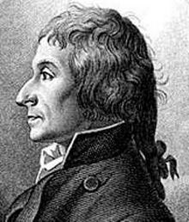
Law of constant proportions
and come to conclusion that
the proportion of each element
in a compound is constant.
He analysed the chemical
composition of a large
number of compounds
The law of constant proportions was
given by proust in 1779.
A chemical compound always consists
of the same elements combined together
in the same proportion by mass.

Slide 26



Law of constant proportions
According to the law of constant proportions.
Water is a compound
which always consists
of the same two
elements, hydrogen
and oxygen.
Combined together
In the same constant proportion of.
1:8by mass
A chemical compound always consists of the same elements combined together in the same proportion by mass.
Ice water
H₂O 1 : 8
River water
H₂O 1 : 8
Sea water
H₂O 1 : 8

Slide 27
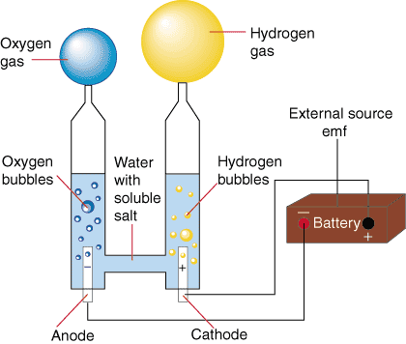
If we decompose 100gm of pure
water by passing electricity through
it, then 11grams of hydrogen and 89 grams of oxygen are obtained.
Now, if we repeat this experiment by taking pure water from different sources(like river, sea, well, etc.)
The same masses of hydrogen and oxygen elements are obtained in every case.
This experiment shows that water always consists of the same two elements, hydrogen and oxygen, combined together in the same constant proportion of 11:89 or 1:8 by mass

Slide 28


Calcium carbonate decomposes, on heating, to form calcium
oxide and carbon dioxide. When 10 g of calcium carbonate is
decomposed completely, then 5.6 g of calcium oxide is formed. calculate the mass of carbon dioxide formed. Which law of chemical combination will you use in solving this problem??
Solution.
This problem is to be solved by using the law of conservation of mass in chemical reaction, calcium carbonate is the reactant whereas calcium oxide and carbon dioxide are products.

Slide 29
Now, from the law of conservation of mass we have:
Mass of products = mass of reactants
Mass of calcium +
Mass of carbon
= Mass of calcium
oxide
dioxide
carbonate
5.6 + Mass of carbon = 10
dioxide
Mass of carbon = 10 – 5.6
dioxide
=4.4 g
Thus, the mass of carbon dioxide formed is 4.4 g.

Slide 30
MODULE : 5
Atoms, Daltons atomic theory and symbols

Slide 31
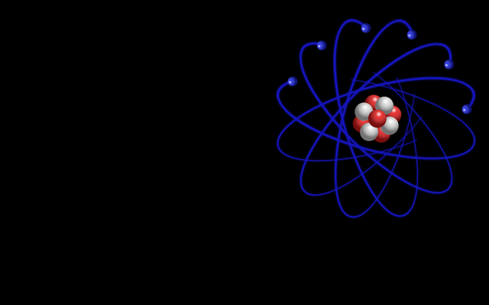
Atoms
All the matter is made up of atoms.
These atoms are building blocks of all the matter around us.
An atom is the smallest particle of an element
than can take part in a chemical reaction.
Atoms are very very small in size.
Atomic radius is
measured in
nanometer.
The size of an atom is indicated by its radius called “atomic
radius”
1nm = 10⁻⁹m
Atomic exist combination with the atoms of same element or
another element.
Atoms of Hydrogen
is smallest at all

Slide 32
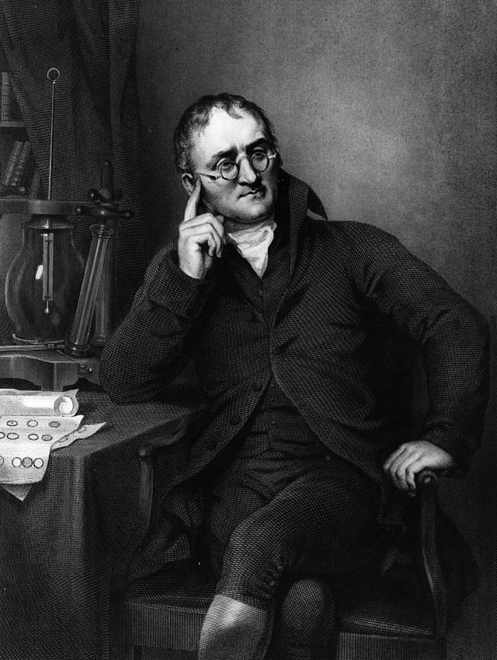
Symbols for some elements
We will first discuss the
Dalton's symbol of
elements and then the
modern symbols
of elements.
The symbol of elements
it means the symbols
of the atoms of the
elements (because
elements are made
up of atoms).
Hydrogen
Carbon
Oxygen
Phosphorus
Sulphur
Iron
Copper
Lead
I
C
L
Silver
Gold
Platina
So Dalton’s symbols
are only of historical
importance
S
P
Dalton’s symbols for
elements were difficult
to draw and inconvenient
to use
G
They are not used at all.
Dalton was the first scientist to use
the symbols for elements in very
specific sense
Mercury

Slide 33
Modern symbols of elements
The symbol of an element is the “first letter” or the “first letter and
another letter” of the English name or Latin name of the element.
The symbol of Hydrogen is H
(First letters of name)
The symbol of Oxygen is O
(First letters of name)
Carbon
There are, however
some elements whose
names begin with
the same letter.
C
C
Calcium
C
Chlorine
C
Copper

Slide 34
In such cases, one of the elements is given a “one letter” symbol
The symbol of Carbon is C
but all other elements
are given “two letter” symbols.
(First letters of name)
The symbol of Calcium is Ca
(First and second
letters of name)
please note that this
“another letter” may or
may not be the
“second letter”
The symbol of Chlorine is Cl
(First and third
letters of name)
The “two letters” are the “first letter ” and “another letter” of the English name or Latin name of the element.
The symbol of Copper is Cu
(First and second letter
of its Latin name Cuprum)

Slide 35
MODULE : 6
Elements and their Symbols

Slide 36
It should be noted that in a ' two letter' symbol the first letter is
the 'capital letter' but the second letter is the small letter'
English name
of the Element
English name
of the Element
Symbol
Symbol
Hydrogen
H
Fluorine
F
Helium
He
Neon
Ne
Lithium
Li
Magnesium
Mg
Boron
B
Aluminium
Al
Carbon
C
Silicon
Si
Nitrogen
N
Phosphorus
P
Oxygen
O
Sulphur
S

Slide 37
English name
of the Element
English name
of the Element
Symbol
Symbol
Chlorine
Cl
Bromine
Br
Argon
Ar
Krypton
Kr
Calcium
Ca
Iodine
I
Manganese
Mn
Barium
Ba
Nickel
Ni
Cobalt
Co
Zinc
Zn
Uranium
U

Slide 38

In our study of chemistry we use the English names of the elements
so we are not familiar with the Latin names of the elements.
Most of the confusion therefore arises in the symbols derived from
the Latin names of the elements.
English name
of the Element
Latin
name
English name
of the Element
Latin
name
Symbol
Symbol
Sodium
Na
Natrium
Gold
Au
Aurum
Potassium
K
Kalium
Mercury
Hg
Hydragyrum
Iron
Fe
Ferrum
Lead
Pb
Plumbum
Copper
Cu
Cuprum
Tin
Sn
Stannum
Silver
Ag
Argentum

Slide 39
Latin name and Symbol of the element
Elements
Latin name
Symbol
Sodium
Natrium
Na
Silver
Argentum
Ag
Tungsten
Wolfram
W
Potassium
Kalium
K
Copper
Cuprum
Cu
Gold
Aurum
Au
Iron
Ferrum
Fe
Lead
Plumbum
Pb
Mercury
Hydragyrum
Hg

Slide 40
MODULE : 7
Atomicity

Slide 41
Interesting fact about Elements
Sometimes elements are named based on their property.
At one time people believed that any substance that contained
oxygen would be acidic in nature.
For example the
Latin word
for water is
‘Hydro’
Place of discovery of element can also play a role in its naming.
So the element that
Combined with oxygen
to give water was named
hydrogen.
The gas which was
first discovered in
the sun (Greek named
for sun is ‘helio’) was
named helium.
Sometimes elements were named to honour the scientists.
The Latin word
for acid is
‘oxy’
Hence the gas
was called
oxygen.
Example: Einsteinium,
Fermium, Rutherfordium
And Mendelevium.

Slide 42
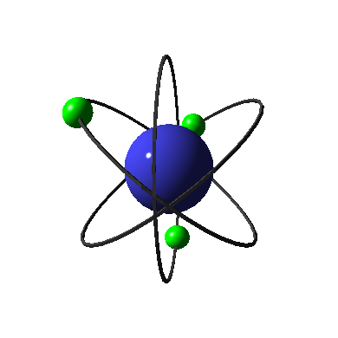

Atomicity

Slide 43

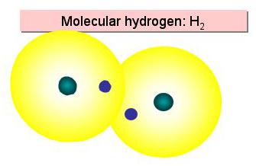
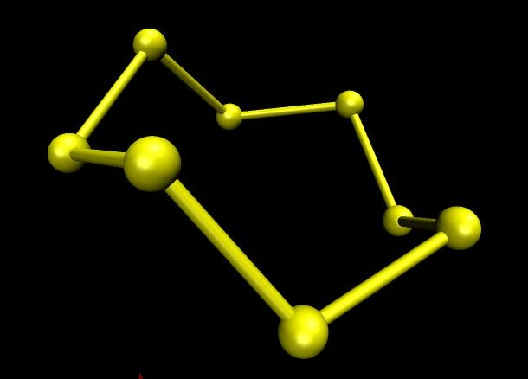

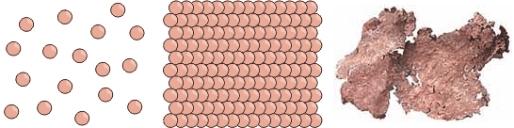
The number of atoms constituting a molecule is known as its Atomicity.
Molecule of Ozone consists of three atoms of Oxygen. Here the atomicity is three; hence it is known as triatomic molecule.
Helium (He), Argon (Ar), Copper (Cu) exist as single atom. Hence they
are known as monoatomic
Molecule of Sulphur consists of eight atoms of Sulphur. Here the
atomicity is eight; hence it is known as Octatomic molecule.
Molecule of hydrogen consists of two atoms of hydrogen. Here the
atomicity is two; hence it is known as diatomic molecule.
It is also
called as S₈
Crown ring

Slide 44
MODULE : 8
Valency

Slide 45


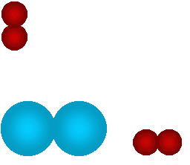






Why do some
elements be
monatomic??
why do elements
have different
atomicities??
Why do some elements
form diatomic or
triatomic molecules??

Slide 46


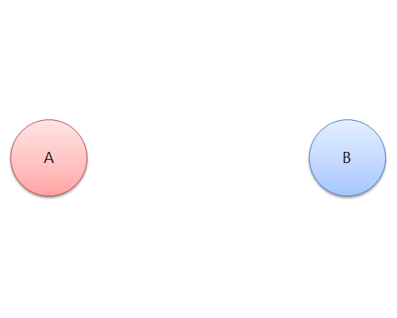
What is
valency??
Every element has a definite combining
capacity, that determines the atomicity
of its molecules.
We call as its
valency.
Every elements reacts with other
elements according to its combining
capacity.

Slide 47
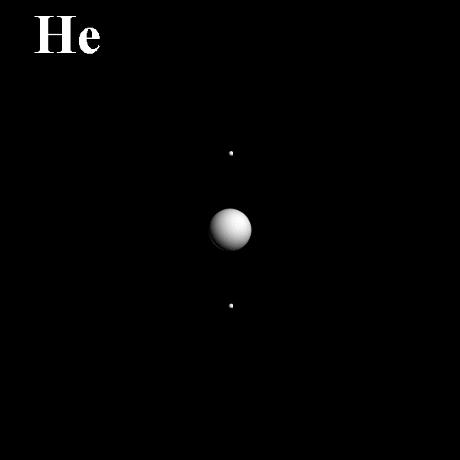
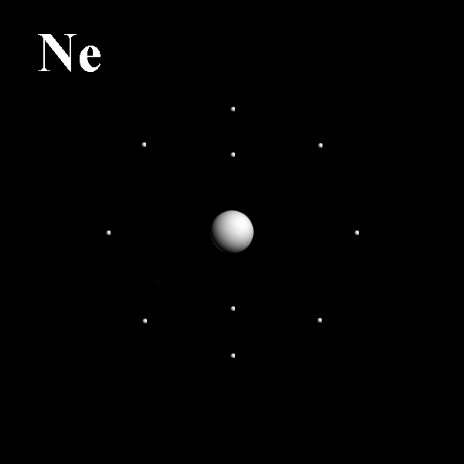
Valency
As in case of
Helium
Two electrons in the
outermost shell
octet electrons in their outermost orbit. i.e. a stable state when there are 8 electrons in their outermost orbit.
All elements tend to complete the duplet or
This they do by donating, accepting or sharing of the outermost orbit with electrons of other elements.
In doing so they form chemical bonds with the other elements
leading to formation of compounds.

Slide 48
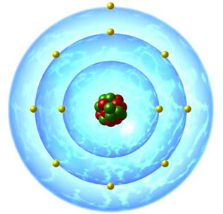

Find out the valency
for sodium
Steps:
Its 11
Find out atomic number of sodium
Write its electronic configuration
2,8,1
Find out weather sodium is stable or
unstable
unstable
To become stable sodium can give 1 electron
or take 7 electrons
For sodium the
nearest inert gas
is Neon
It is easy to give 1 electron.
and achieve the inert gas
electronic configuration
∴Valency of sodium is 1

Slide 49
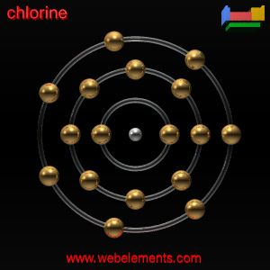
Valency of chlorine
The atomic number of chlorine is 17, so
its electronic configuration is 2,8,7.
The chlorine atom has 7 electrons in its
Outermost shell
It needs 1 more electron to achieve the
8 electron configuration
Since one chlorine atom gains 1 electron to achieve the inert gas electron configuration, so the electrovalency of chlorine is1

Slide 50
Valencies of Some Common Metal Elements
Metals tend
to give away
electrons
Element
Symbol
Metals are
electropositive
Valency
Element
Symbol
Valency
Lithium
Li
1
Magnesium
Mg
2
Sodium
Na
1
Calcium
Ca
2
Ferrous
Ferric
Potassium
K
1
Zinc
Zn
2
Cupric
Cuprous
Silver
Ag
1
Mercuric
Iron
Fe
2 and 3
Mercurous
Copper
Cu
1 and 2
Aluminium
Al
3
Mercury
Hg
1 and 2

Slide 51
Valencies of Some Common Non - Metal Elements
Non-metals tend
accept or share
electrons
Element
Symbol
Non-metals are
electronegative
Valency
Element
Symbol
Valency
Hydrogen
H
1
Sulphur
S
2
Fluorine
F
1
Nitrogen
N
3
Chlorine
Cl
1
Phosphorus
P
3
Bromine
Br
1
Carbon
4
C
Iodine
I
1
Oxygen
O
2

Slide 52
MODULE : 9
Ions and Polyatomic Ions

Slide 53


What is an
ion??
Compounds formed by metals and
non metals contain charged species.
The charged species are known as ions.
For example: Sodium ion is
written as Na⁺ and chloride
ion as Cl⁻
A negatively charged ion is called anion
and the positive charge ion is cation.

Slide 54
Valencies of some elements
What is an
ion??
Element
Valency
Helium
0
Compounds formed by metals and
non metals contain charged species.
Hydrogen
1
Fluorine
1
Chlorine
1
The charged species are known as ions.
Oxygen
2
A negatively charged ion is called anion
and the positive charge ion is cation.
Nitrogen
3
Carbon
4

Slide 55
Some Common, Simple and poly atomic ions
Net charge
Cation
Symbol
Anion
Symbol
Hydrogen
H⁺
Hydride
H⁻
Sodium
Na⁺
Chloride
Cl⁻
1 Unit
Potassium
K⁺
Bromide
Br⁻
Silver
Ag⁺
Iodide
I⁻
Copper *
Cu⁺
Hydroxide
OH⁻
Ammonium
NH₄⁺
Nitrate
NO₃⁻
Magnesium
Mg⁺²
Oxide
O⁻²
Calcium
Ca⁺²
Sulphide
S⁻²
2 Units
Sulphate
Valency of an ion
is equal to the
Magnitude of
its charge.
Zinc
Zn⁺²
SO₄⁻²
Copper*
Cu⁺²
Carbonate
CO₃⁻²
Valency of oxide ion
(O⁻²) is 2.
Iron*
Fe⁺²
Dichromate
Cr₂O₇⁻²
Aluminium
Al⁺³
Nitride
N⁻³
3 Units
Iron*
Fe⁺³
Phosphate
PO₄⁻³

Slide 56
MODULE : 10
Atomic Mass

Slide 57
Atomic Mass
The most remarkable concept that Dalton’s atomic theory proposed was that of the atomic mass.
In 1961, it was universally
accepted the mass of
carbon- 12 atom would be
used as a standard reference
for measuring atomic
masses of other elements.
According to him, each elements had
a characteristic atomic mass.
Since, atoms are extremely light and small, scientist find it difficult to measure their individual masses.
Earlier scientist used
Hydrogen as a
reference standard.
Hence, the mass of the atom is
compared with a standard atomic mass of some other element.
Since hydrogen has no neutrons.

Slide 58
Atomic Mass
Hydrogen being the smallest atom is taken as a standard particle for Comparing masses of other atoms
O
Na
Cl
Ca
N
C
H
He
N
H
H
H
H
H
H
H
=
H
H
H
H
H
H
H
1 atom of nitrogen
14 atoms of hydrogen
Therefore RELATIVE MASS OF NITROGEN ATOM IS 14

Slide 59
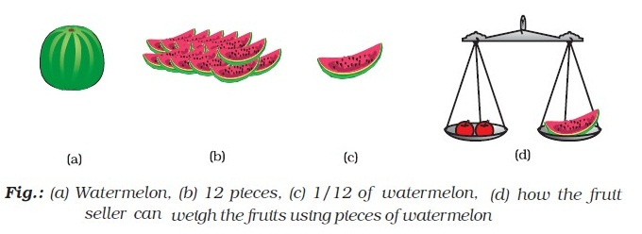
Definition of Atomic Mass
The atomic mass of an element is defined
as the average mass of all the isotopes of
the element as compared to 1/ 12th of the
mass of one carbon -12 atom.
Which is cut into
12 equal pieces
Imagine carbon
atom is like a
watermelon
1 piece represents
1/12 of carbon
Atomic mass of an element is a ratio and
has no units and is expressed in amu.
According to latest IUPAC recommendations
the amu has been replaced by ‘u’, which is
known as unified mass.
Now use this piece
to weigh other
Atoms.

Slide 60
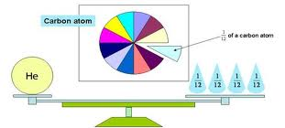
How to weigh
Helium Atom???
Carbon atom
1
Of a carbon
atom
12
He
1
Mass of 1 Helium atom is 4 times mass of carbon atom Atomic mass of helium is 4 u.
12

Slide 61

Atomic masses of a few important elements
Element | Atomic mass (u)
Element | Atomic mass (u)
Hydrogen
1
Aluminium
27
Carbon
12
Phosphorus
31
Nitrogen
14
Sulphur
32
Oxygen
16
Chlorine
35.5
Sodium
23
Potassium
39
Magnesium
24
Calcium
40

Slide 62
MODULE : 11
Chemical formula of compounds

Slide 63
Let’s study how to write molecular formula

Slide 64
The following steps should be taken while writing the chemical formula of magnesium chloride.
1.Write the symbol of each atom side by side, usually the
cation first and anion next Mg Cl.
2.Write the valency of each atom above
its symbol
2
1
3. Interchange the valency and write
the number to the lower right of the
constituents as their subscript Mg₁Cl₂
Mg
Cl
Mg₁Cl₂
Mg Cl₂
4. If any constituent receives the number 1, ignore it while writing the formula.
5. If a constituent has more than one atom enclose it with in brackets.

Slide 65


(b) Formula for Calcium oxide:
Valency
2
2
Symbol
Ca
O
Here, the valencies of the two elements are the
same.
You may arrive at the formula Ca₂O₂. But we
Simplify the formula as CaO.

Slide 66
(b) Formula of Calcium hydroxide:
valency
2
1
Symbol/
Formula
Ca
OH
Formula : Ca(OH)₂
Here, the bracket around OH with a subscript 2
indicates that there are two hydroxyl (OH) groups
joined to one calcium atom, In other words, there
are two atom each of oxygen and hydrogen in
calcium hydroxide.
Note that the formula of calcium hydroxide is
Ca(OH)₂ and not CaOH2 . We used brackets when we
have two or more of the same ions in the formula.

Slide 67
MODULE : 12
Molecular mass and Numericals

Slide 68

Molecular Mass
The molecular mass of a
substance is the sum of the
atomic masses of all the
atoms in a molecule of the
substance. It is therefore the
relative mass of a molecule
expressed in unified mass
units.(u)

Slide 69

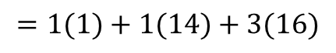
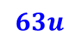
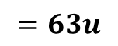
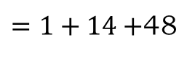
Molecular Mass
HNO₃
Calculate the molecular mass of (Nitric acid)
(
)
(
)
(
)
1
Atomic mass
of hydrogen
Atomic mass
of Nitrogen
Atomic mass
Of Oxygen
1
3
$$=1(1)+1(14)+3(16)$$
$=1+14+$48
$$=63u$$
Molecular mass of is
$$63u$$
HNO₃

Slide 70

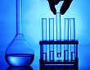
Molecular Mass
Molecular Mass = Sum of Atomic Masses
H₂O =
No of ‘H’
atoms
Atomic Mass of H
No of ‘O’
atoms
Atomic Mass of O
2
Atomic Mass of H
No of ‘O’
atoms
Atomic Mass of O
H₂O =
No of ‘H’
atoms
1
1
16
= 2
16
= 18 u

Slide 71
Calculate the molecular mass of H₂SO₄
2 atomic mass
of hydrogen
(atomic mass
of sulphur)
(4 $×$atomic mass of oxygen) = (2 $×$1) + 32 + (4 $×$ 16) = 98u

Slide 72
MODULE : 13
Mole concept theory

Slide 73



Banks have an extremely large number of coins of various denominations.
Counting of such a large number of coins
is a difficult job.

Slide 74

So, in banks, they weigh coins, rather
than count them.
The bank people know that a fixed
number of a particular coin will always
have the same mass.
In chemistry also, scientist link the
mass of an element or compound to the
number of atoms or molecules present
in them .

Slide 75
Mole Concept
Take an example of the reaction of hydrogen
and oxygen to form water:
It is more convenient to refer to the quantity
of a substance in terms of the number of its
molecules or atoms rather than their masses.
2H2 + O2 = 2H2 O
The above reaction indicates that
So, a new unit “mole” was introduced.
One mole of any species (atoms, molecules, ions or particles) is that quantity in number having a mass equal to its atomic or molecular mass in grams.
Two molecules of hydrogen combine with one molecule of
oxygen to form two molecules of water.

Slide 76
MODULE : 14
Molar mass and Numericals

Slide 77





The number of particles (atoms, molecules or ions) present in a mole
of any substance is fixed, with a value of 6.022 $×$10 .
23
This number is called Avogadro constant
(N_{A}) named in honour of the Italian
scientist, Amedeo Avogadro.
This is an experimentally obtained value.
12
12
1 mole (of anything) = 6.022 $×$10 in number,
23
as, 1 dozen = 12 nos.
as, 1 gross = 144 nos

Slide 78

Molar Mass
When molecular mass is expressed in gram it is called as Molar mass
For example molecular mass of water (H₂O)=18u.
Molar mass of water = 18 g
18 u water has only one molecule of water.
But 18 g water has one mole molecules of water that is
6.022$×$10²³ molecules

Slide 79



Molar mass of CaCO₃
= Mass of Ca + Mass of C + Mass of O$×$3
= 40+12+16 $×\text{3}$
= 40+12+48
= 100g
1 Mole of CaCO₃ =100gm and contains 6.022$×$10²³
Molecules of CaCO₃

Slide 80

1. How many moles are 5 grams of calcium? (Atomic mass of calcium = 10𝝁 )
Solution :
We know that
1 mole of atoms
= Gram atomic mass
So, 1 mole of Calcium atoms
= 40 g
So, x mole
= 5 g
OR
Mass in grams
5
∴ No of moles =
∴ x =
Gram atomic mass
40
m
i.e n =
1
M
∴ x =
8
5
n =
40
∴ x =
0.125 mole
1
n =
8
Thus, there are 0.125 mole in 5 g of calcium.
Ans :
n = 0.125 mole

Slide 81

What is the mass of 4 moles of aluminium atoms ? (Atomic mass of A1 = 27$μ$ )
Solution :
1 Mole of al A1 atoms
= 27 g
So, 4 males of A1 atoms
= 27 × 4 g
= 108 g
Thus, the mass of 4 moles of A1 atoms is 108 grams
OR
m
∴ N =
M
∴ N = 4 moles
M = 27 g
m
so, 4 =
27
m = 4 × 27 g
Ans :
m = 108 g

Slide 82
3. How many moles are 9.033 × 10²⁴ atoms of helium (He) ?
OR
Solution :
1 mole
= 6.022 × 10²³ atoms
So, x mole
= 9.033 × 10²⁴ atoms of helium
n
N
=
N_{A}
9.033 × 10²⁴
n
= no. of moles
∴
x
=
6.022 × 10²³
n
= given number of particles
∴
x
3
=
× 10^{24 –23}
N_{A}
= Avogadro’s number = 6.022 × 10²³
2
x
n
=
9.033 × 10²⁴
= 15 moles
∴
6.022 × 10²³
n
=
3
× 10¹
∴
2
∴
n
=
1.5 × 10
Ans :
n = 15 moles

Slide 83
4. What is the number of molecules in 0.25 moles of oxygen ?
Solution :
1 mole of oxygen contains
= 6.022 × 1023 molecules
OR
So, 0.25 mole of oxygen contains
= x
n
N
∴
x
= 6.022 × 10²³ × 0.25
=
N_{A}
∴
0.25
=
N
x
=
1.505 × 10²³ molecules
∴
6.022 × 10²³
Thus, 0.25 mole of oxygen contains 1.505 × 10²³ molecules.
∴
N
=
6.022 × 10²³ × 0.25
Ans :
N = 1.505 × 10²³ molecules.

Slide 84

5. Calculate the number of iron atoms in a piece of iron weighing 2.8 g. (Atomic mass of iron = 56 $μ$ )
Solution :
1 mole of iron
= Gram atomic mass of iron
= 56 grams
OR
Also 1 mole of iron element
= 6.022 × 10²³ atoms
Now, 56 g of iron
= 6.022 × 10²³ atoms
m
N
=
× N_{A}
So, 2.8 g of iron
= x
M
2.8
6.022 × 10²³ × 2.8
∴
n
=
× 6.022 × 10²³
∴
x
=
56
56
6.022 × 10²²
n
=
6.022 × 10²²
∴
x
=
∴
2
2
∴
n
=
1.5 × 10
x
= 3.011 × 10²² atoms
Ans :
N = 3.011 × 10²² atoms

Slide 85


6. Calculate the mass of 3.011 × 10²⁴ molecules of nitrogen molecule (N₂)(Atomic mass = 14 $μ$ )
Solution :
1 mole of N₂
= Molecular mass of N₂ in grams
= 28 grams
OR
1 mole of N₂
= 6.022 × 10²³ molecules
N
m
=
× N_{A}
6.022 × 10²⁴
= x
M
So, 2.8 g of iron
= x
∴
m
3.011 × 10²⁴
=
× 6.022 × 10²³
28
∴
x
28 × 3.011 × 1024
=
28 × 3.011 × 10²⁴
6.022 ×1023
∴
m
=
6.022 × 10²³
x
= 140 g
Ans :
m = 140 g

